Slide 1
STUDENT-CENTERED LEARNING
ENDRO DWI HATMANTO

Slide 2
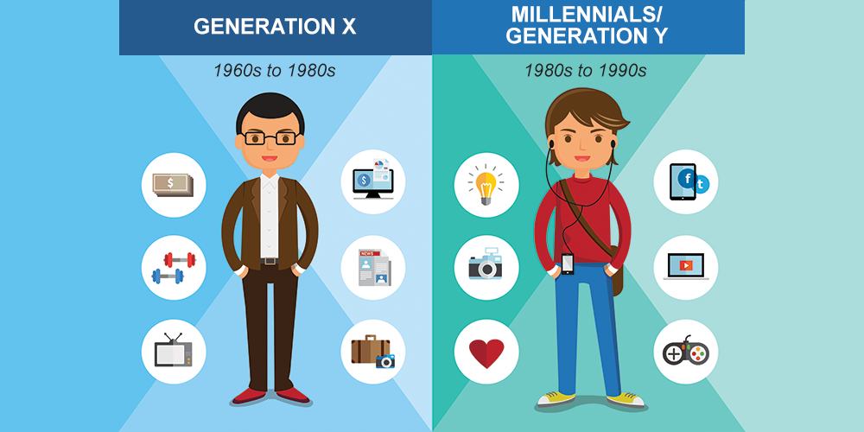
TANTANGAN DOSEN ZAMAN NOW: LAHIRNYA GENERASI MILLENIAL

Slide 3
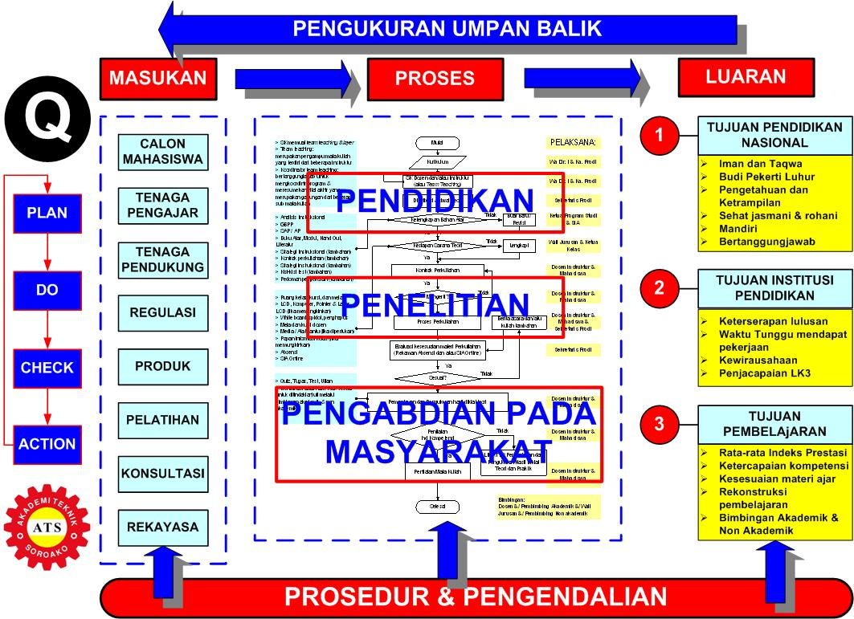
TANTANGAN DOSEN ZAMAN NOW: MENGAJAR MENJADI BAGIAN DARI KUALITAS PT

Slide 4
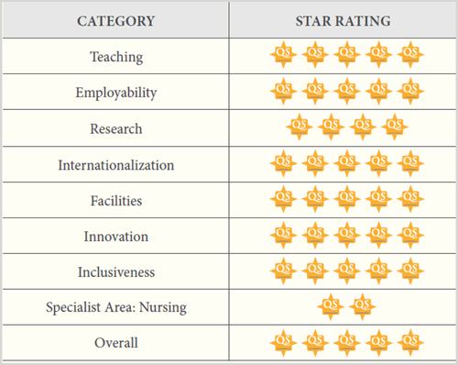

Slide 5
Rating Universities on Teaching: QS Stars
Overall student satisfaction (40 points)
Completion (40 points)
Satisfaction with teaching (40 points)
Faculty with PhD (40 points)
Further study (20 points)
Student/faculty ratio (50 points)

Slide 6
“Good teaching can engender a genuine passion for a subject within students, as well as allowing them to achieve highly and enabling them to pursue the subject independently (QS STARS, 2015)”

Slide 8
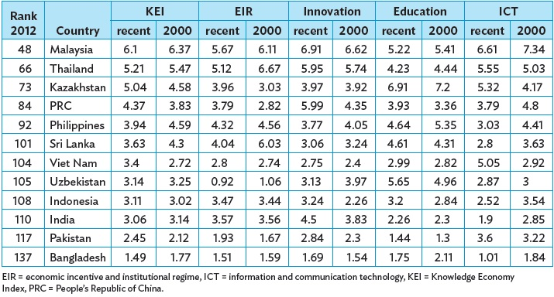
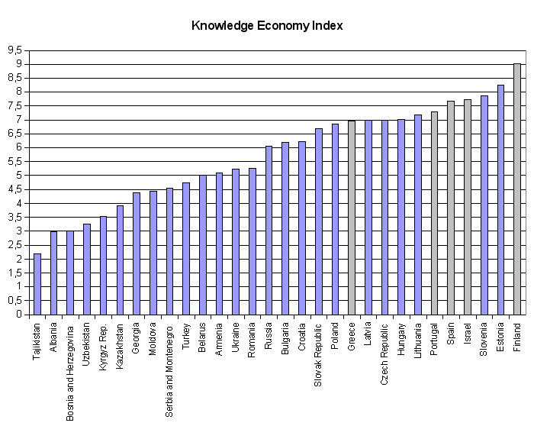
TANTANGAN DOSEN ZAMAN NOW: KUALITAS ADALAH BAGIAN DARI AGAMA

Slide 9
MENJAWAB TANTANGAN: JADILAH DOSEN UMY ZAMAN NOW !

Slide 10
SELAMAT TINGGAL DOSEN ZAMAN OLD

Slide 11
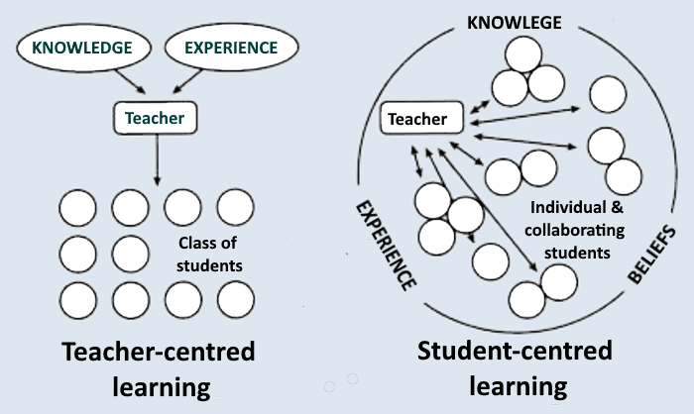
DOSEN ZAMAN OLD VS DOSEN ZAMAN NOW

Slide 12
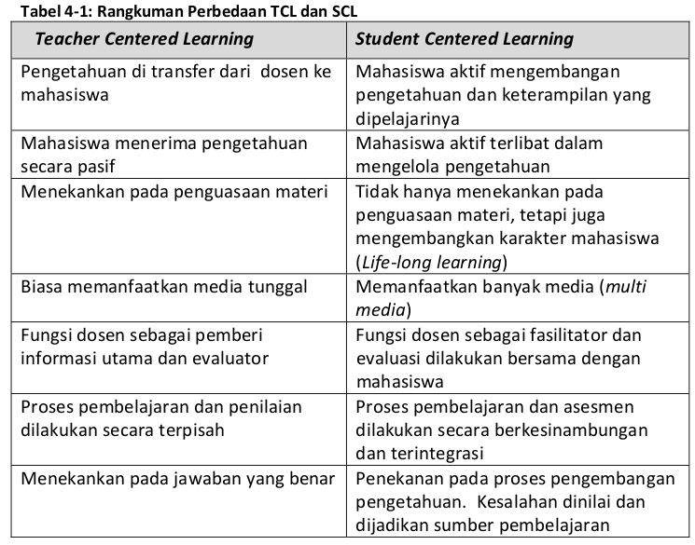

Slide 13
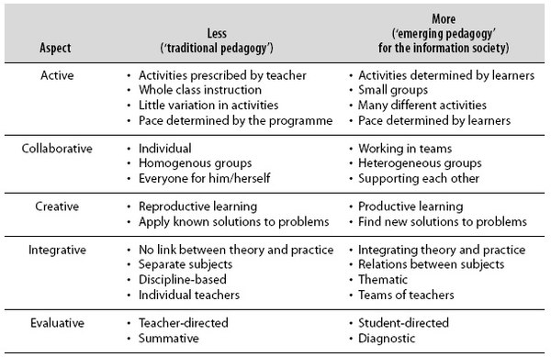
TEACHING MILLENIAL GENERATION

Slide 14
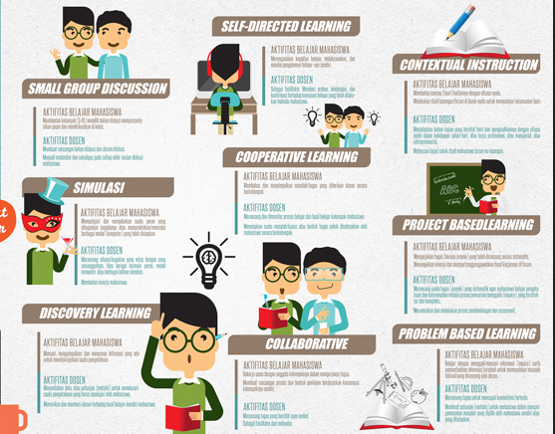

Slide 15
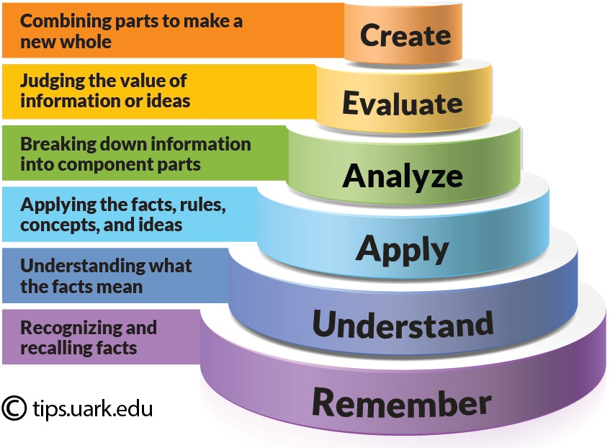
Case study: pengajaran di Australia

Slide 17
Two keys to teach using SCL successfully:
Help students to construct their knowledge (cognitive constructivism).
Help them to learn from each other through collaborative and cooperative learning.

Slide 18
Let’s see how SCL works !

Slide 19
Problem-based learning
Skenario
BADANKU KOK PANAS?
Seorang mahasiswa baru kedokteran UMY yang sedang mengikuti OSMARU hari ketiga merasa badannya sangat lemas dan tubuhnya demam. Oleh panitia OSMARU dibawa ke Medical Center UNS. Dari anamnesis didapatkan bahwa mahasiswa tersebut selama OSMARU mengurangi minum karena khawatir terlalu sering ijin ke toilet. Pemeriksaan dokter menunjukkan tekanan darah 100/70mmHg, denyut nadi 110x/ menit, suhu tubuh 38,2°C. Temannya juga dibawa ke Medical Center UNS dengan keluhan demam sejak 3 hari yang lalu, demam tinggi terus menerus disertai nyeri saat menelan. Sebelumnya sudah minum obat penurun demam, tetapi demam hanya turun sebentar kemudian naik lagi. Pemeriksaan fisik menunjukkan tekanan darah 120/80mmHg, denyut nadi 96x /menit, suhu tubuh 39,5°C.

Slide 20
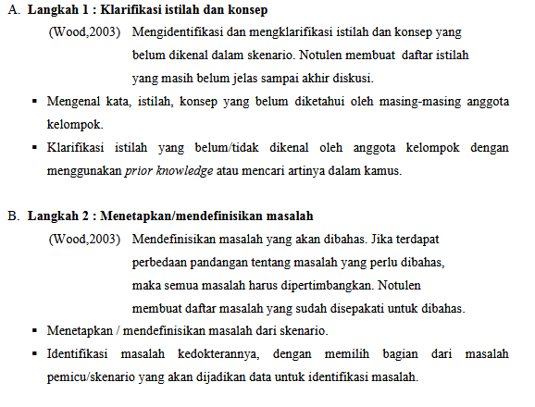
Seven jumps in PBL

Slide 21
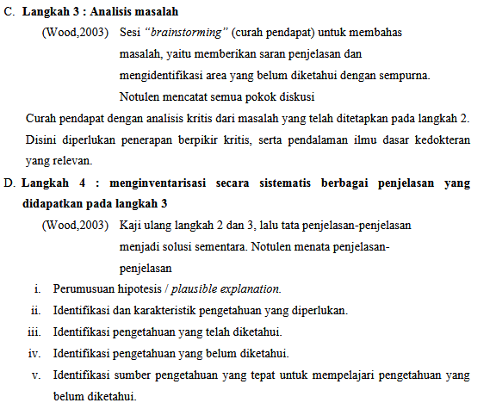

Slide 22
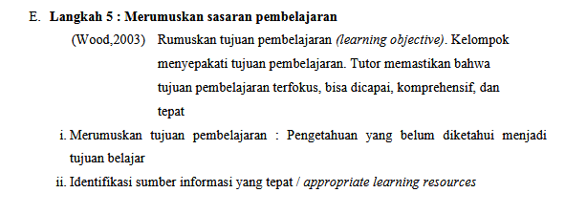

Slide 24
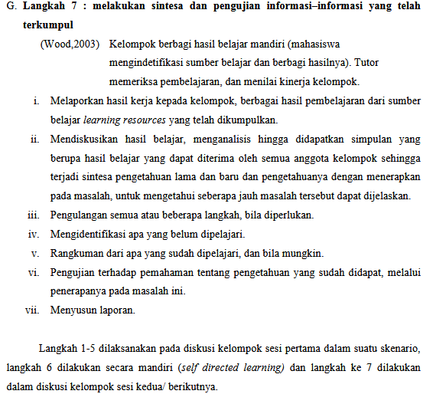

Slide 26
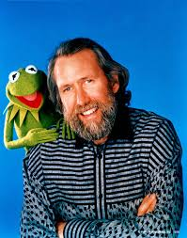
“[Kids] don't remember what you try to teach them. They remember what you are.” ― Jim Henson, It's Not Easy Being Green: And Other Things to Consider

Slide 27
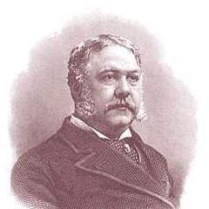
“The mediocre teacher tells. The good teacher explains. The superior teacher demonstrates. The great teacher inspires.” ― William Arthur Ward

Slide 30
We are educators, not only teachers !
As a teacher we not only teach, but also educate.
What is the different between ‘teaching’ and ‘educating’?

Slide 31
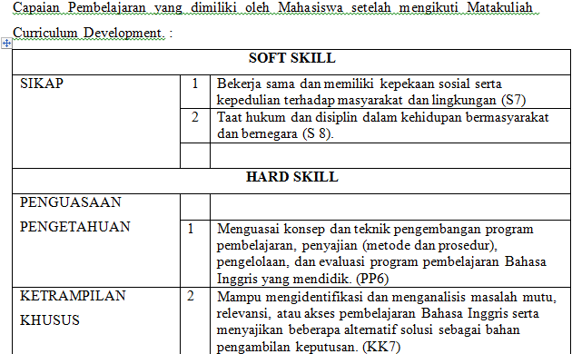

Slide 32
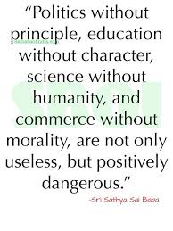

Slide 33
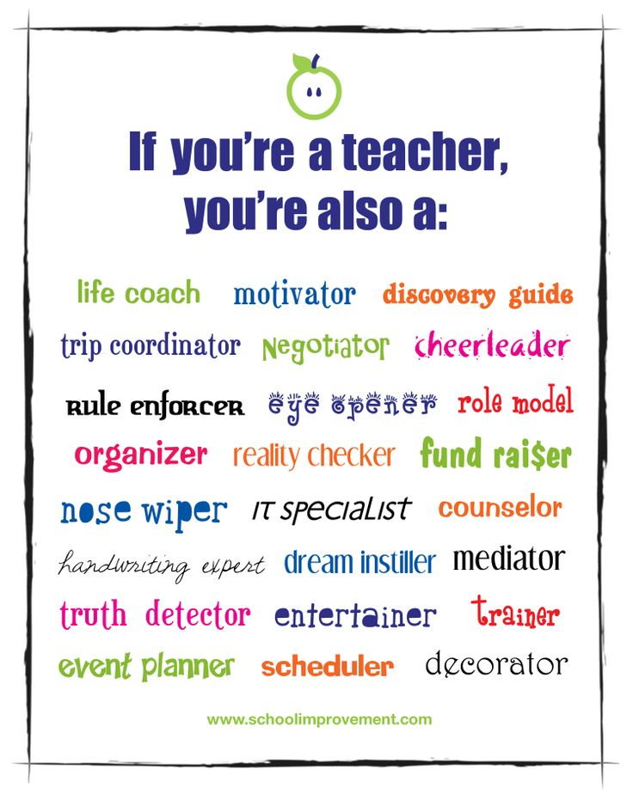

Slide 34
Terimakasih

