Slide 1
Writing and Selecting on Reputable Journal Indexing
Dr. Nuryakin, MM
SCOPUS ID : 57191417126
Orchid : 0000-0002-4998-9601
Publikasi di laman Scopus : 8
H Indeks SCOPUS : 3
Program Magister Manajemen
UMY, 2018

Slide 3
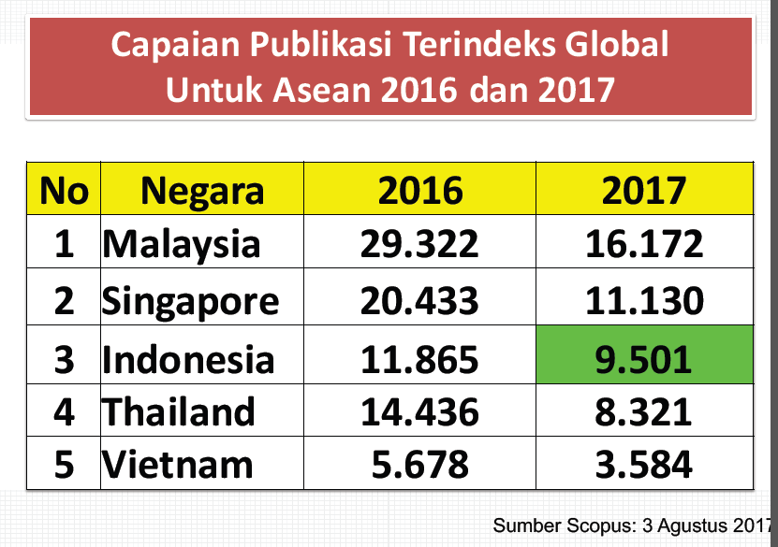

Slide 4
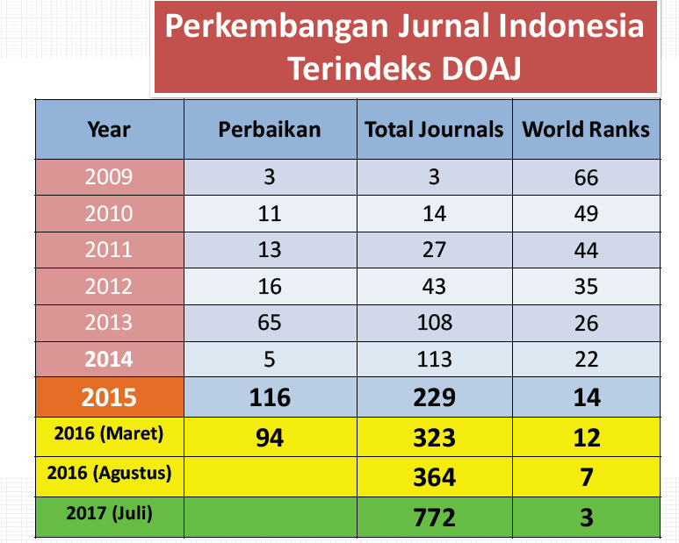

Slide 6
What is Scopus?
Largest Citations and Abstract database – 16,700+ sources from 4,000 publishers
Comprehensive Scientific, Technical, Medical and Social Sciences coverage. Arts & Humanities
Quality Web Sources – Institutional Repositories
Patent searching from 5 major patent offices
Citations Analysis of your researchers, institution, journal, research area
Intuitive interface, Citations Analysis
Focused
web
information
16,700+ titles
STM &
Social
sciences
SCOPUS
Academic
library
sources
Repositories

Slide 7
Measuring Research Quality
Classic measure of research quality
Citations per staff member (not per paper)
Number of publication per staff
Source: Scopus (http://www.scopus.com
Notes:
77

Slide 8
Scopus-indexed publications
Research article
Review
Proceeding
Book/book chapter

Slide 9
The Scientific Manuscript
Expanded IMRAD Model
(Title)
Abstract
Introduction
Materials and Methods
Results
Discussion
Figures/Graphs
Tables
References
IMRAD format:
Introduction
Materials and Methods
Results and
Discussion

Slide 10
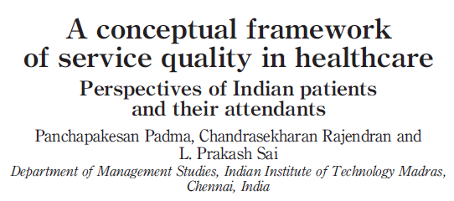
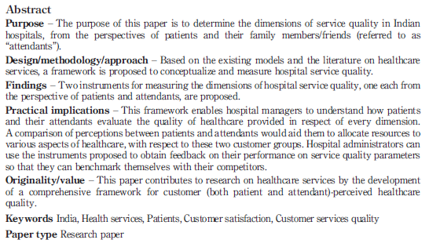
The Scientific Manuscript
Title
Purpose of the study
Methods
Result
Implication
Uniqueness

Slide 11
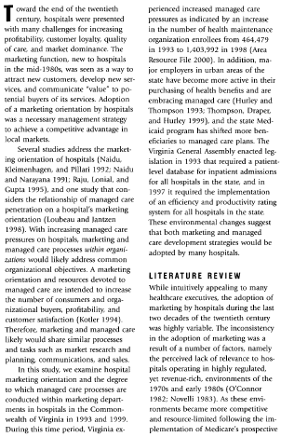
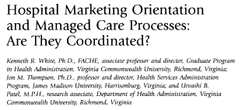
MASALAH:
FENOMENA
MASALAH:
RESEARCH GAP

Slide 12
MASALAH:
RESEARCH GAP

Slide 13
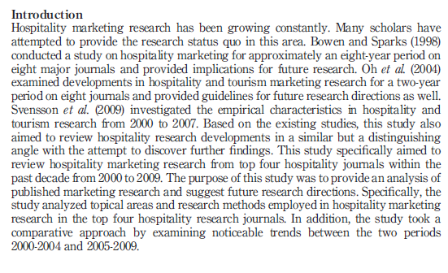
BACKGROUND YANG MENANTANG

Slide 14
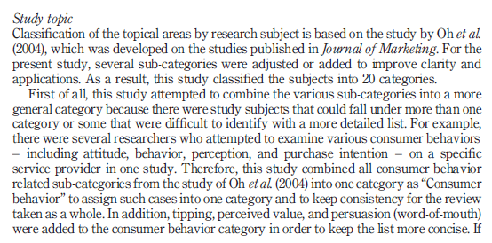
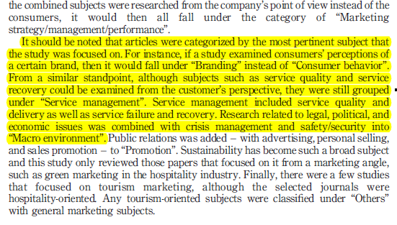
BACKGROUND YANG MENANTANG

Slide 15
The Purpose of this research
Narasi Tujuan Studi yang berfokus pada kontribusi akademis yang akan dihasilkan maupun kontribusi aplikatif
Pada bagian ini ditulis tujuan penelitian→ penulis hendahknya kreatif dalam menyatakan pikirannya mengenai tujuan, tidak sekedar menambahkan kata “ ingin mengetahui” terhadap semua kalimat pertanyaan penelitian.
The purpose of this study……..
Kontribusi Teoretikal
Kontribusi Praktikal

Slide 16
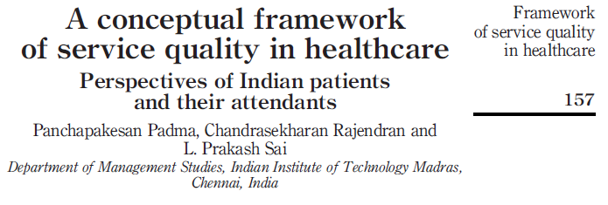
TUJUAN

Slide 17
TUJUAN

Slide 18
GAP
TUJUAN

Slide 19
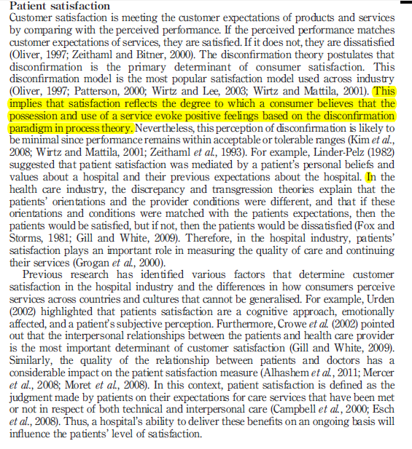
Literature
Review

Slide 20
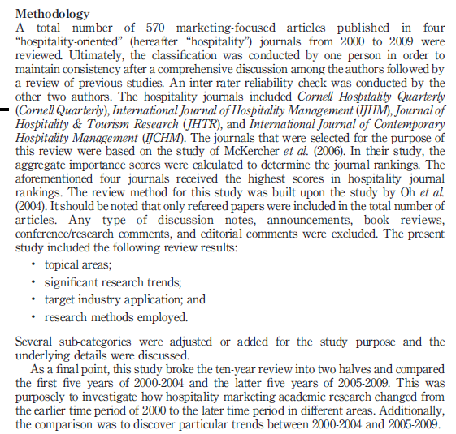
Research Methods

Slide 21
Cara mengutip pustaka dan Penulisan daftar pustaka
MENULIS KUTIPAN
Tiap jurnal mempunyai style yang berbeda, tetapi pada dasarnya adalah menulis nama dan tahun penulis (Kumoro dkk., 2012) atau menulis angka arab [1, 2, 3, ….] yang menunjukkan urutan munculnya pustaka tersebut di dalam teks.
DAFTAR PUSTAKA
Metode Harvard
Metode Vancover
Dapat ditulis secara manual atau menggunakan bantuan software, misalnya Software/Freeware MENDELEY yang dioperasikan secara online

Slide 22
Being liquid phases with rather different densities, any temperature increase of the reaction will result in increasing mass transfer in the phase containing triglycerides to the glycerol phase and increases solubility of both phases, which finally increase the reaction rate [13].
[2] M. L. Damstrup, T. Jensen, F. V. Sparsø, S. Z. Kiil, A. D. Jensen, and X. Xu, “Solvent Optimization For Efficient Enzymatic Monoacylglycerol Production Based On A Glycerolysis Reaction”, Journal of American Oil Chemists Society, (82) (2005), pp. 559- 564.
[8] N. Krog, Lipid Technologies and Applications. New York: Marcel Dekker, 1997.
[13] P. Chetpattananondh, J. Rukprasoot, C. Bunyakan, and C. Tongurai, “Glycerolysis Of Crude Glycerol Derived From Biodiesel Process”, in Proceeding of PSU-UNS International Conference on Engineering and Environment, Novi Sad, Serbia & Montenegro, 2005.

Slide 23
The typical gas hold-up behaviour as a function of the power input shown in Figure 9, for Rushton turbine and Pitched blade turbine (Pantula and Ahmed, 1998).
Pandit A. B. and J. B. Joshi, “Mixing in Mechanically Agitated Gas-Liquid Contactors, Bubble Columns and Modified Bubble Columns,” Chem. Eng. Sci. 38, 1189–1215 (1983).
Pantula, R. R. K. and N. Ahmed, “Solid Suspension and Gas Hold-up in Three Phase Mechanically Agitated Contactor,” Proceedings of the 26th Australian Chemical Engineering Conference (Chemica 98) Port Douglas, Australia (1998).
Rewatkar, V. B., “Studies in Mechanically Agitated Multiphase Reactors,” PhD Thesis, University of Mumbai, India (1990).
Nienow, A. W., “The Suspension of Solid Particles” in “Mixing in the Process Industries,” 2nd ed., N. Harnby, M. F. Edwards and A. W. Nienow, Eds. Butterworths, London, U.K. (1992), pp. 364–393.

Slide 24
Indexing Journal

Slide 26
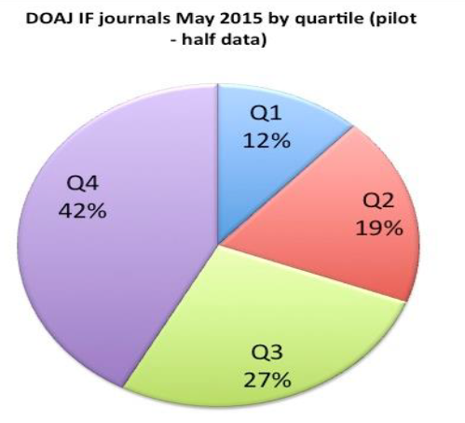
Ranking Quarterly Scimagojr.com

Slide 27
Scopus-indexed publications
Research article
Review
Proceeding
Book/book chapter

Slide 28
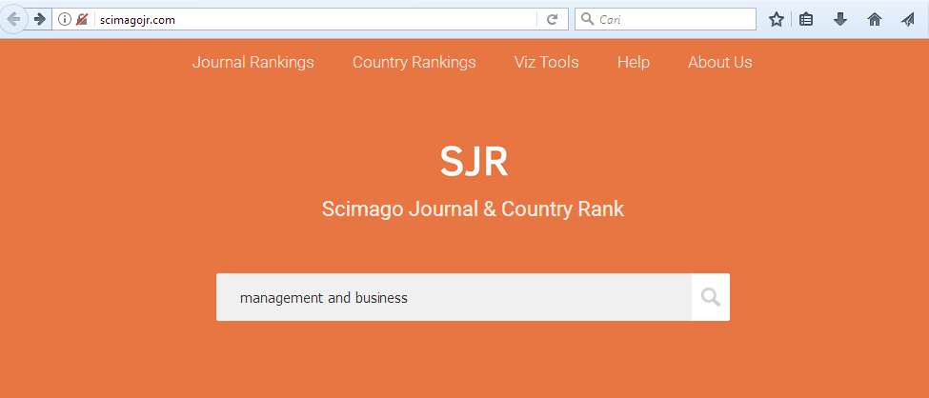
Cara memilih Jurnal Indeks Scopus
Pilih www.scimagojr.com

Slide 29
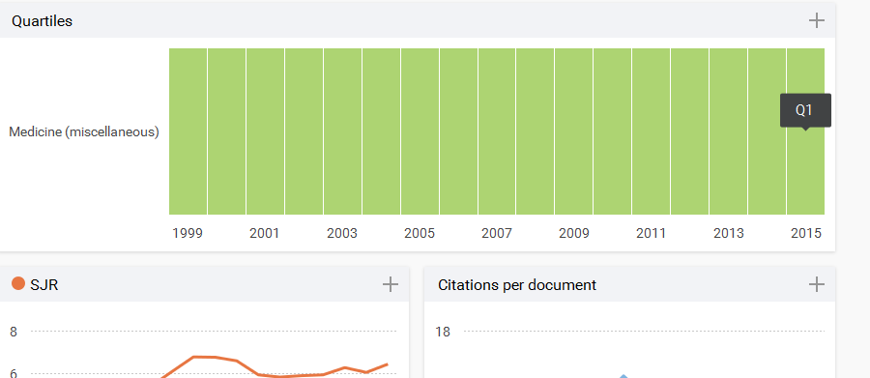
Top Ranking Journal

Slide 30
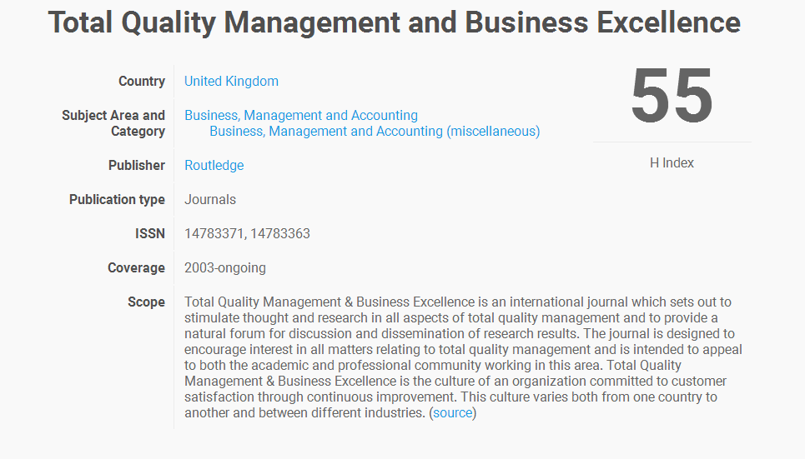
The Jornal of the American Medical Association

Slide 31
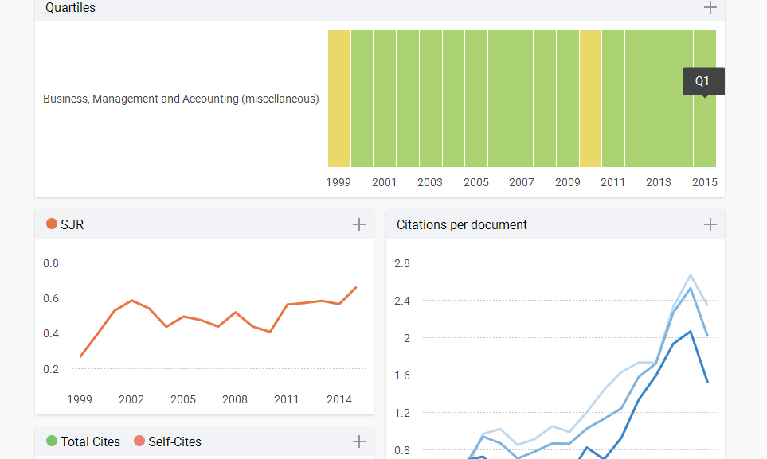
Quartil Ranking Journal (Q1)

Slide 32
Warning (Hati-hati memilih Publisher)
Sebaiknya hindari PREDATORY Journal
Cek Editor Board nya
Cek Coverage journal (Volume aktif publishnya)
Cek Indexing journal

Slide 33
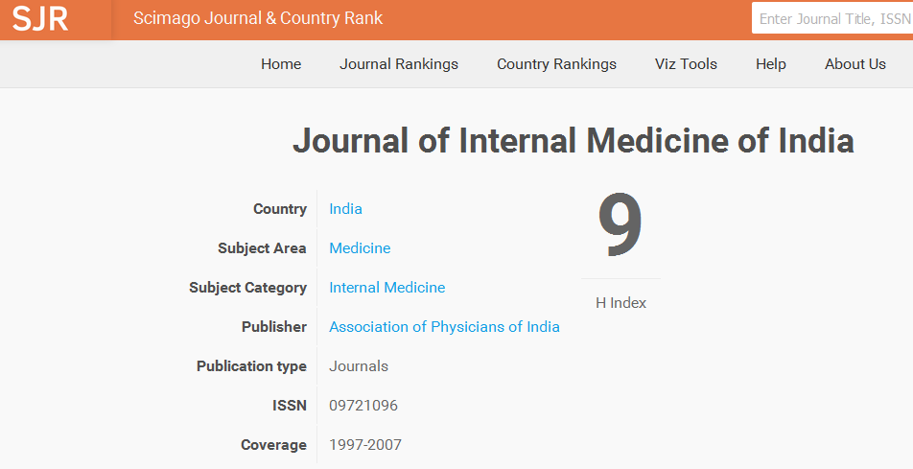
Coverage aktif Journal

Slide 34
Warning

Slide 35
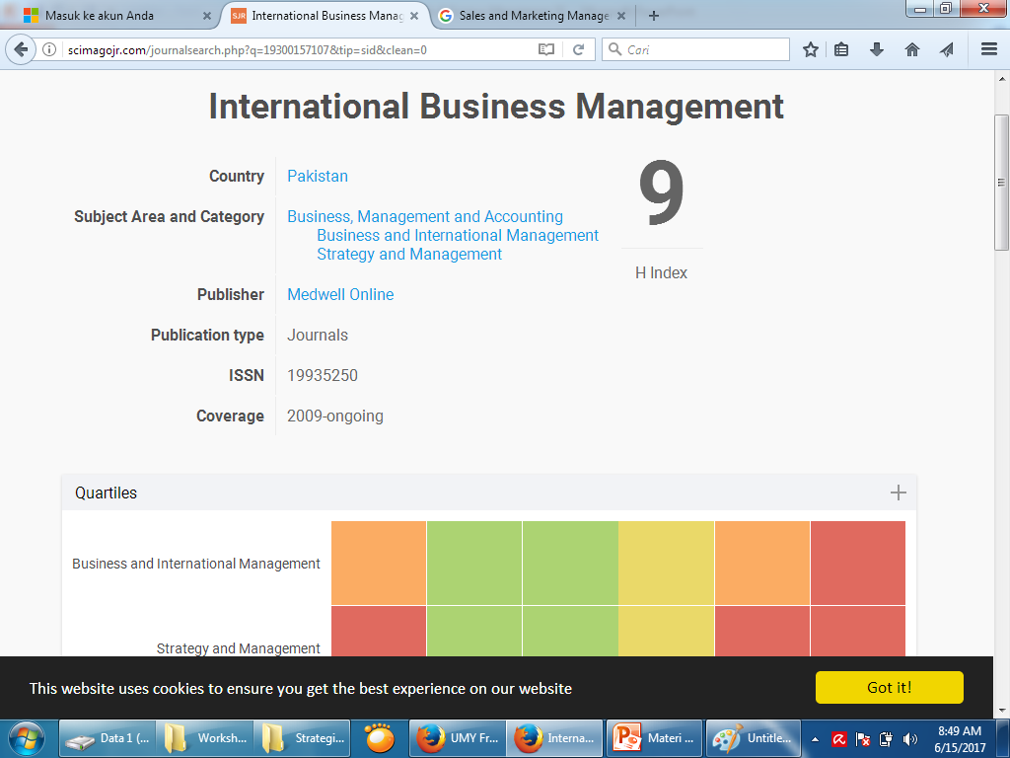

Slide 36
Jurnal Indeks Scopus di Indonesia

