Slide 1
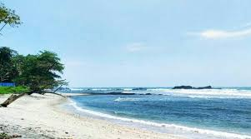
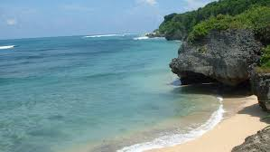
Penilaian Angka Kredit Dosen dalam Kebijakan Merdeka Belajar – Kampus Merdeka
Prof. Dr. Indah Susilowati
Fakultas Ekonomika & Bisnis -UNDIP
Email: prof.indah@gmail.com
UNIVERSITAS MUHAMMADIYAH YOGYAKARTA – Sabtu, 12 Desember 2020

Slide 2
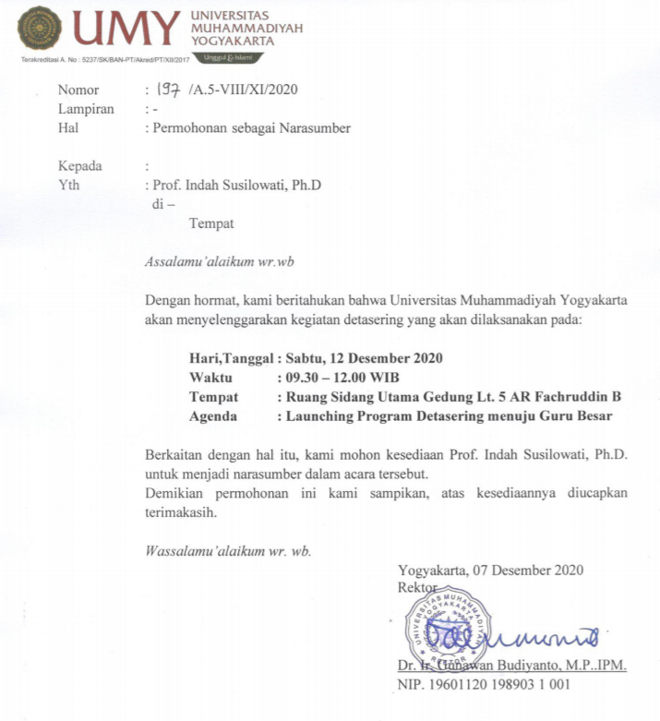

Slide 4
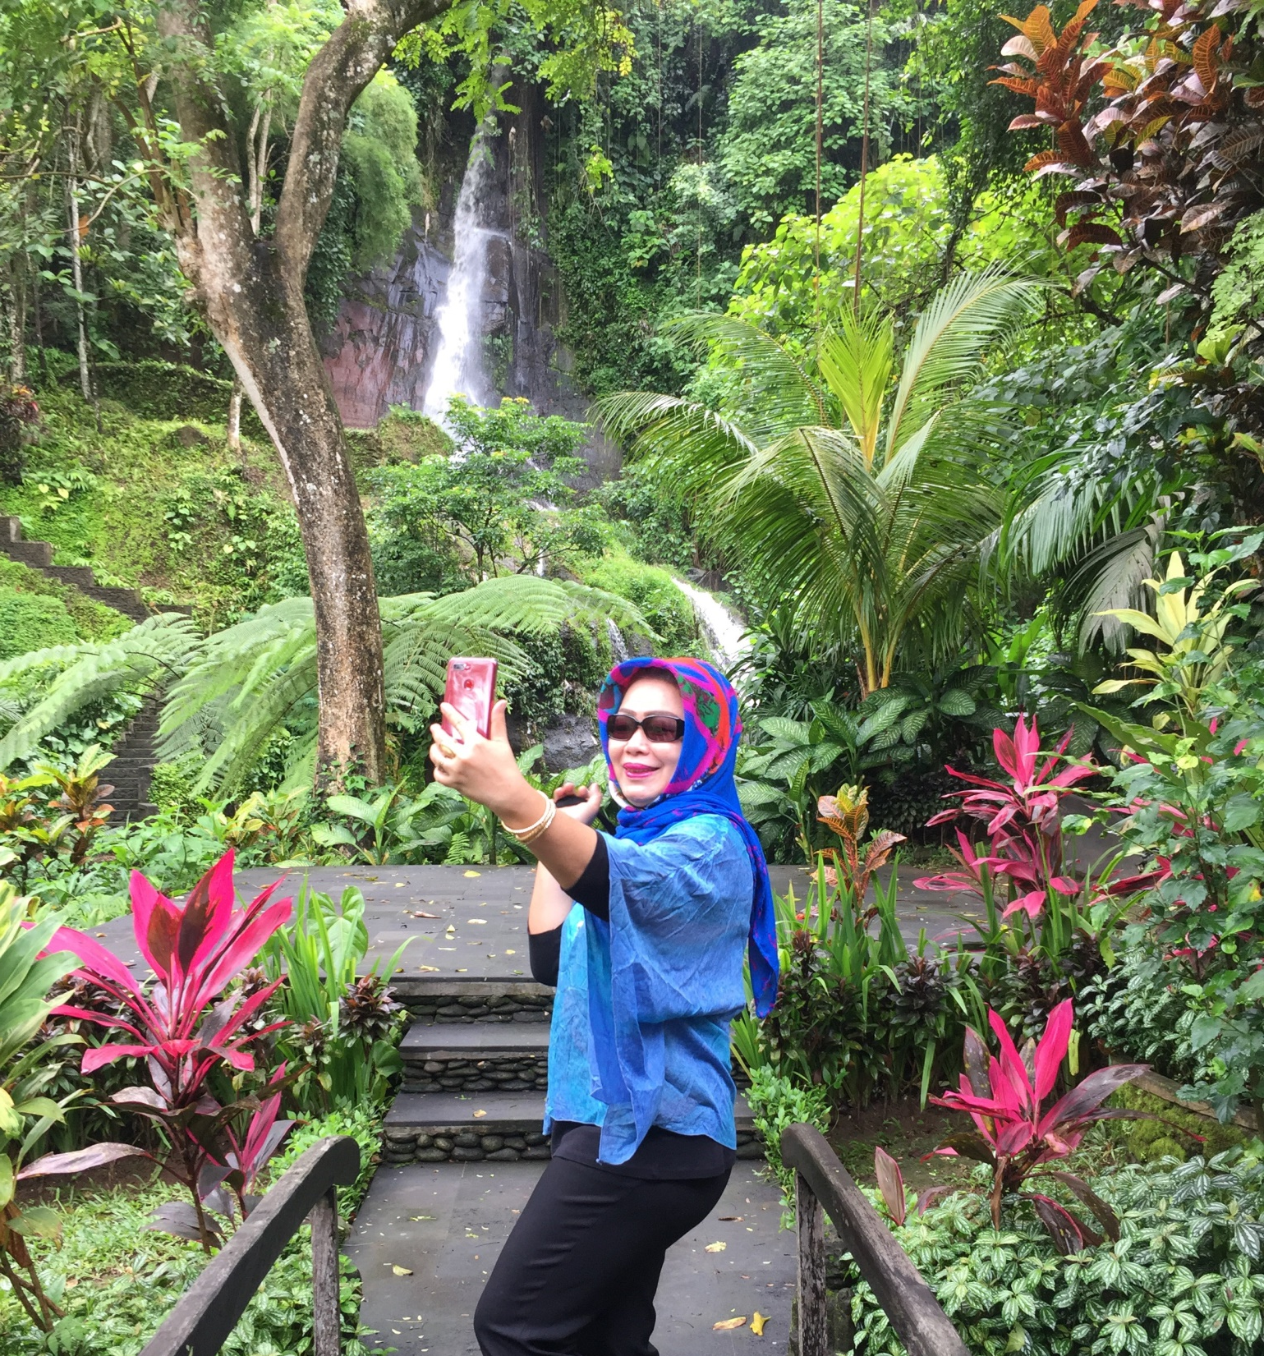
INDAH SUSILOWATI is a professor in Diponegoro University (UNDIP).
is a lecturer with homebased in Faculty of Economics and Business, and several postgraduate programs in UNDIP.
a member of Senate Academic of Diponegoro University since 2015.
as reviewer for research works, professorships, and the accreditation of study programme/ and institution since 2005 at the Directorate of Higher Education Degree, Ministry of Education, the Government of Indonesia
as principle investigator of many research with the theme in Coastal Resource Management/ Small Scale Fisheries (SSF)/ Gender in Fisheries and Aquaculture.

Slide 5
Bagaimana kita menyikapi nya ……??
Bermula dari ini ……..

